Slide 1


Electric Vehicle Sales in India (by 01.01.2024)
By Danish Iqbal

Slide 2


National
Overview
Total EVs Sold:
Top 3 States:
Total EVs Sold in 2024: Approximately 3.5 million units across India.
Uttar Pradesh, Maharashtra, and Karnataka collectively accounted for 40% of total EV sales. ​

Slide 3
Top 10 States by EV Sales
State | Total Sales | Percentage
Uttar Pradesh | 732074 | 20.37 %
Maharashtra | 401535 | 11.17 %
Karnataka | 315498 | 8.78 %
Delhi | 268538 | 7.47 %
Rajasthan | 228573 | 6.36 %
Bihar | 213465 | 5.94 %
Tamil Nadu | 206902 | 5.76 %
Gujarat | 176713 | 4.92 %
Assam | 151917 | 4.23 %
Kerala | 133246 | 3.71 %
Monitor Economic Indicators

Slide 4

Sales by Vehicle Class
2- Wheelers
3- Wheelers
4- Wheelers
Others
1808105
Accounted for 50.3% of total EV sales.
1620310
Accounted for 45%
149775
Accounted for 4%
15621
Accounted for 0.4%

Slide 5
Usage by Category – Personal vs Commercial vs Others
Personal Use
Commercial Use
Others
1927437
Makes 53.6 % of all Sales
E-scooters, electric cars, bikes
1657762
Makes 46.1 % of all Sales
E-rickshaws, delivery EVs, fleet autos
8612
Makes 0.2 % of all Sales
Electric buses, official fleets

Slide 6
Most Popular Vehicle Types.
Type | Total Sales
2W_Personal | 1796340
3W_Shared_LowSpeed | 1408127
4W_Personal | 130676
3W_Goods_LowSpeed | 90656
3W_Shared | 76132
3W_Goods | 44974
4W_Shared | 19099
2W_Shared | 11765
Monitor Economic Indicators

Slide 7
Year-wise sales
Type | Total Sales
2023 | 1525179
2022 | 1024723
2021 | 331498
2019 | 166819
2024 | 143182
2018 | 130254
2020 | 124684
2017 | 87420
2016 | 49855
2015 | 7805
2014 | 2392

Slide 8
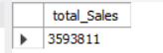
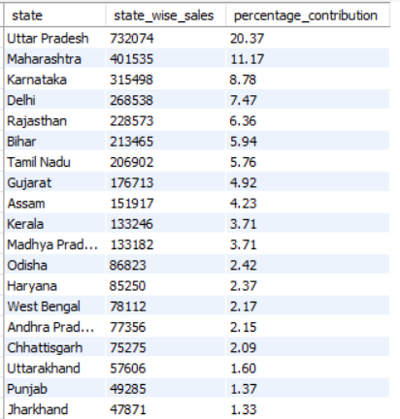
Querying the Database – EV Sales by State
1. Total Sales
SELECT SUM(EV_Sales_Quantity)
AS total_Sales
FROM ev_sales;
2. State Wise Sales:
SELECT
state,
SUM(EV_Sales_Quantity) AS state_wise_sales,
ROUND(
100.0 * SUM(EV_Sales_Quantity) / SUM(
SUM(EV_Sales_Quantity)
) OVER (),
2
) AS percentage_contribution
FROM
ev_sales
GROUP BY
state
ORDER BY
state_wise_sales DESC;
Monitor Economic Indicators

Slide 9
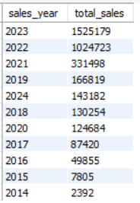
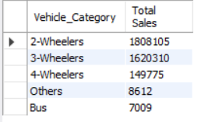
Querying the Database – EV Sales by State
3. Year-wise sales:
SELECT
YEAR(`Date`) AS sales_year,
SUM(EV_Sales_Quantity) AS total_sales
FROM
ev_sales
GROUP BY
sales_year
ORDER BY
SUM(EV_Sales_Quantity) DESC;
4. Distribution of sales by vehicle class (2W, 3W, 4W):
SELECT
Vehicle_Category,
SUM(EV_Sales_Quantity) as 'Total Sales'
from
ev_sales
GROUP BY
Vehicle_Category
ORDER BY
SUM(EV_Sales_Quantity) DESC;
Monitor Economic Indicators

Slide 10
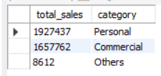
Querying the Database – EV Sales by State
5. Compare personal vs commercial vs others usage:
SELECT
SUM(EV_Sales_Quantity) AS total_sales,
'Personal' AS category
FROM
ev_sales
WHERE
vehicle_type LIKE '%Personal%'
UNION ALL
SELECT
SUM(EV_Sales_Quantity) AS total_sales,
'Commercial' AS category
FROM
ev_sales
WHERE
vehicle_type NOT LIKE '%Personal%'
AND vehicle_type <> 'Others'
UNION ALL
SELECT
SUM(EV_Sales_Quantity) AS total_sales,
'Others' AS category
FROM
ev_sales
WHERE
vehicle_type LIKE '%Others%'
Monitor Economic Indicators

Slide 11
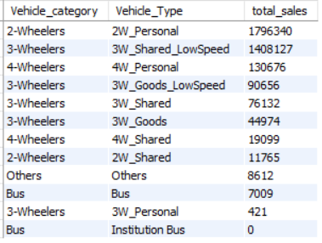
Querying the Database – EV Sales by State
6. Identify most popular vehicle types.
SELECT
Vehicle_category,
Vehicle_Type,
SUM(EV_Sales_Quantity) AS total_sales
FROM
ev_sales
GROUP BY
Vehicle_category,
Vehicle_type
ORDER BY
total_sales DESC;
Monitor Economic Indicators

Slide 12
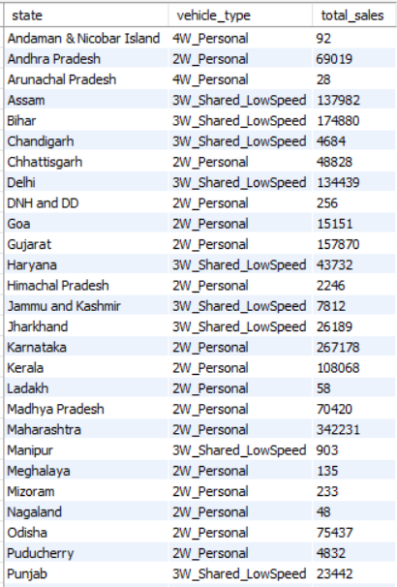
Querying the Database – EV Sales by State
7. Most popular vehicle type in each state
SELECT
state,
vehicle_type,
total_sales
FROM
(
SELECT
state,
SUM(EV_Sales_Quantity) AS total_sales,
vehicle_type,
RANK() OVER (
PARTITION BY state
ORDER BY
SUM(EV_Sales_Quantity) DESC
) AS sales_rank
FROM
ev_sales
GROUP BY
state,
vehicle_type
) AS sales
WHERE
sales_rank = 1;
Monitor Economic Indicators

Slide 13
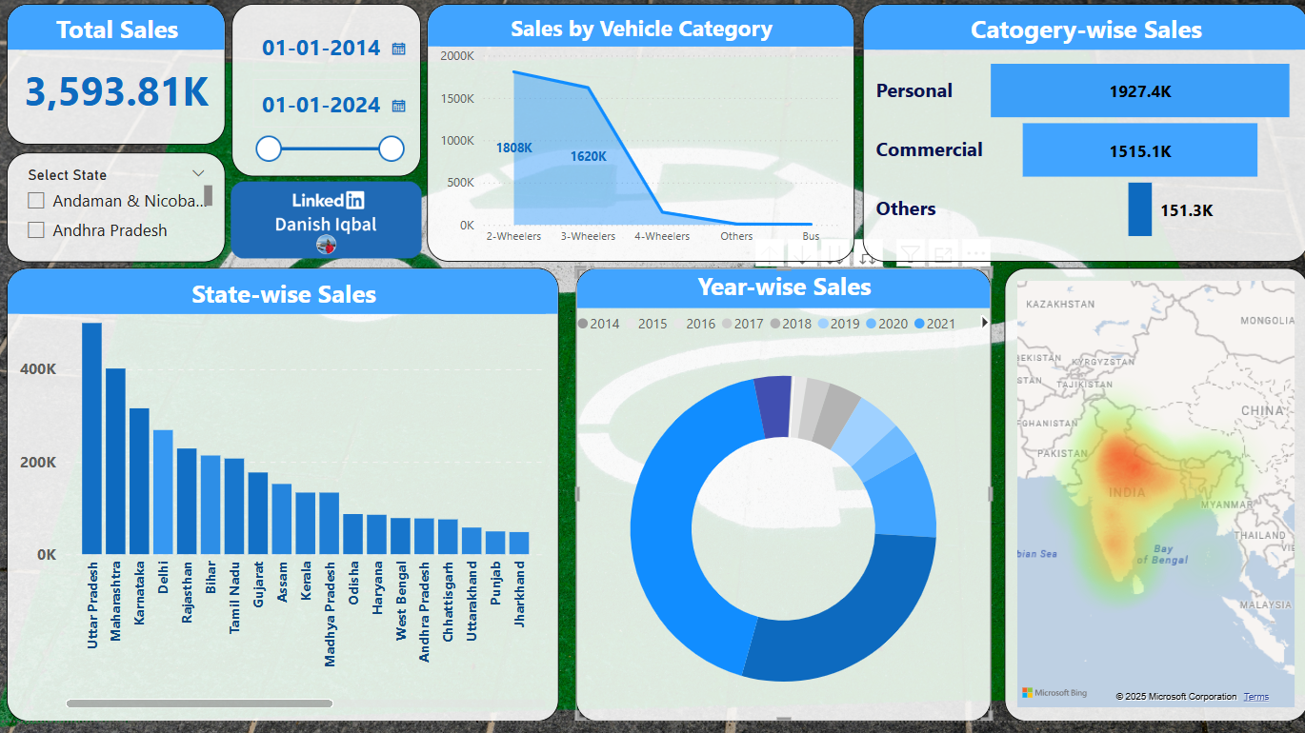
Power BI Dashboard
Monitor Economic Indicators

Slide 14

Conclusion
India’s EV revolution is multi-dimensional.
While personal usage drives early adoption, commercial usage ensures scalability.
A balanced growth in all three segments is key to achieving net-zero emissions goals.

Slide 15
Thank You!
If you have any questions or feedback,
feel free to reach out at:
danishmarazi@gmail.com
or connect with me on
LinkedIn
www.linkedin.com/in/danish-iqbal-355713180

